Slide 1
303 Lab Tutorial
Control design

Slide 2

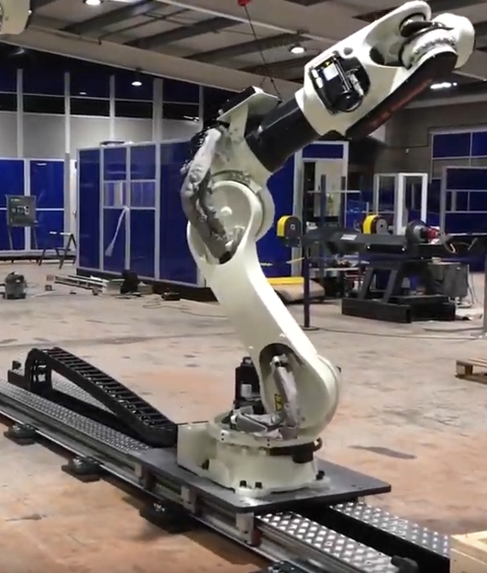
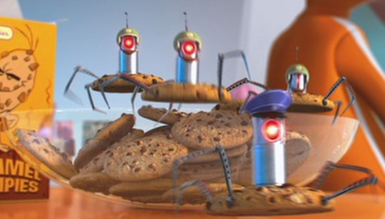
Your task
You have been contracted by Purple Minions Ltd to do some control design for their ‘Cookie Robot™ manufacturing assembly line
https://www.youtube.com/watch?app=desktop&v=A-CDfddh2jQ

Slide 3
Your task
You have been contracted by Purple Minions Ltd to do some control design for their ‘Cookie Robot™ manufacturing assembly line
Robotic arm
Cart
Track
100mm
Positional step change

Slide 4
Task
Work in groups of ~3 to:
Design at least 3 sets of control gains (but you should probably do more) for
P control
PD control
PID control
Test them in the lab!
… rinse and repeat
Write an individual report about your findings

Slide 5
Labs
Run every afternoon over week 5, from 2 – 5pm
Lab slots last 30min (3 groups per slot)
2 Apparatus (2 slots) going at once
Sign up sheet outside Rodney Elliott’s office (E123)
Can repeat the lab as many times as you like!
Calculate sets of PID gains
Test in the Lab
(15min slot)
Did you get the response you wanted?
Write report

Slide 6
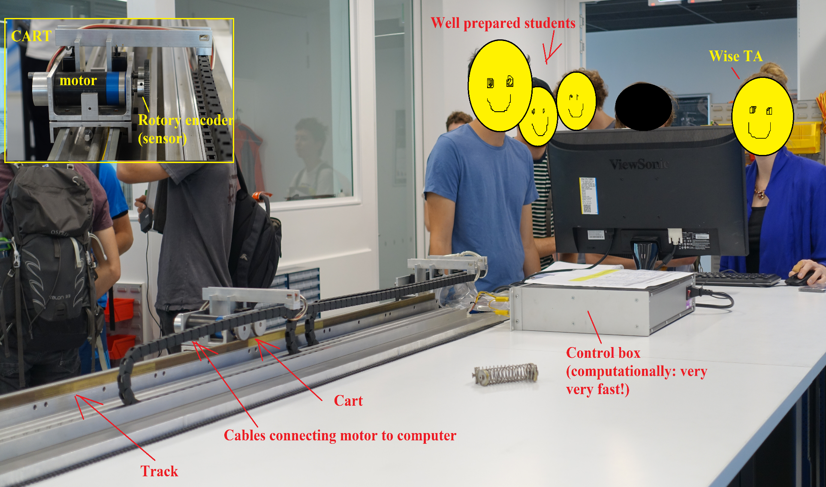
The System
x

Slide 7
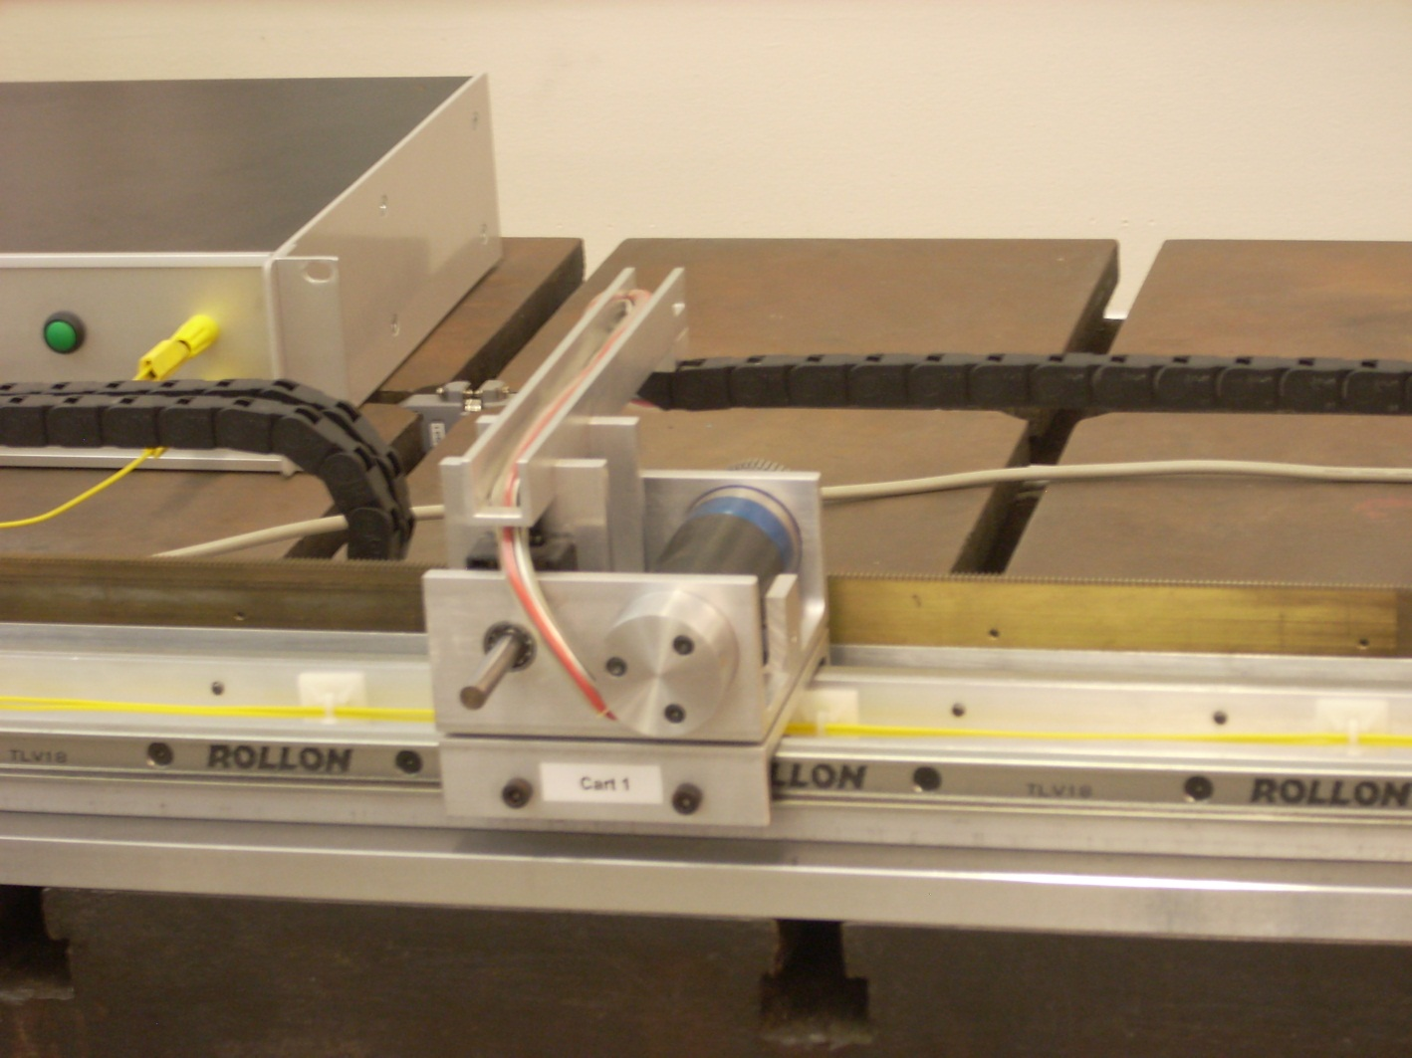
Cart/load

Slide 8
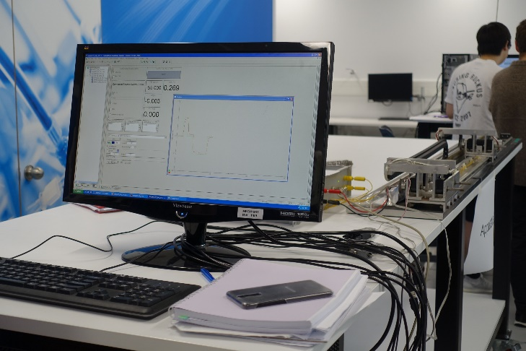
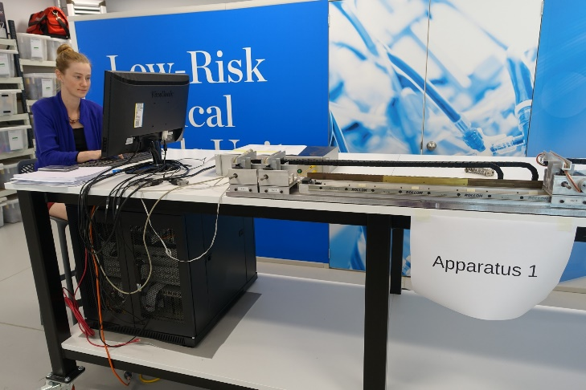
The System
x
Friction force
M_{C}

Slide 9
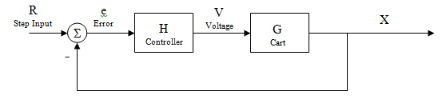
PD:
The System
Design Criteria:
A cart system is to be subject to a 100mm step input in the lab. Feedback control must be implemented to meet the following design specifications.
ξ | > | 0.1
Mp% | < | 30%
e_{ss} | < | 0.1mm
t_{r} | < | 0.5sec

Slide 10
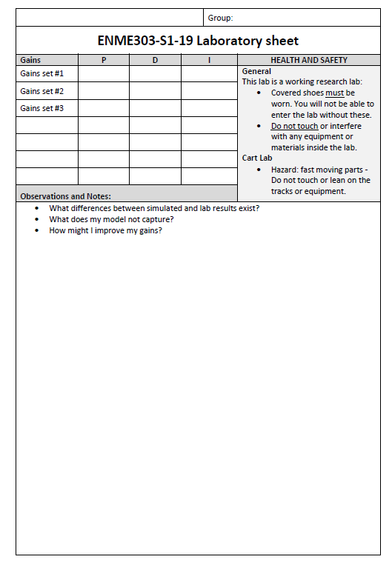
Bring
Lab sheet with your gains written on it
H&S:
Covered shoes must be worn
No touching other projects/equipment in the robotics lab
No touching the lab equipment while the cart is in motion

Slide 11
Lab report due Friday of Term 2 week 1 – short write up
Reporting back to the ‘client’:
What system response characteristics the client could expect for different types of control (P,PD,PID), and which control type is most appropriate for this application.
Whether the system specifications were achieved and any trade-offs in performance and effort/cost (e.g. voltage as a surrogate for energy requirements).
Gains vs. response: how changing the gains affects system response.
Aspects of the model provided by the client compared to a laboratory set up (was the model good enough? Did it match the real-world prototype behaviour?).
Based on your results how many assembly tasks can be performed per hour?

Slide 12
Some Matlab Commands
The following may prove useful
sys = tf(num,den), where num and den are polynomials to represent the numerator and denominator in your transfer function
[y,t,x] = step(sys) = step input command outputting all responses for a system you defined (sys).
You can calculate the voltage input from the states, x, returned
Using step alone gives just a plot of the step response
Stepinfo(sys) = returns a plot with rise time, settling time, overshoot etc all marked and given values. Handy!
Or just calculate by hand as you design
Others may be helpful, but these will get you started if you need help.
These are vaguely remembered by Prof Chase, use “help (command)” in Matlab to be sure!

Slide 13
Some points to consider
Why does the cart behave differently than in Matlab?
Can I change the model parameters after the lab to better match what I saw in the data? Which ones and why?
Consider trying a new set of gains based on what you learn
These answers and trying again are what make an excellent lab write up at the end

Slide 14
Report
5 pages + title page
Short report – keep it concise!
Choose your data and figures wisely
Discuss the why of your results, not just how you got them!
REPORTS ARE INDIVIDUAL! No group reports please!
Marked on :
Content (discussion, key methods, results)
Results presentations (well formatted plots!)
Structure/style (is it hard to read, or missing bits?)

Slide 15
Report cover page
Themed – a bit of fun in the monotony of study….

Slide 16



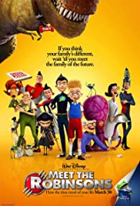





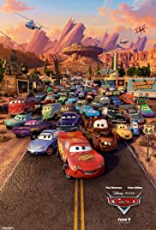











Report cover page
Themed – a bit of fun in the monotony of study….
This years theme: Movies of your childhood
Poetry and creativity encouraged
We like a laugh
Rules
No offensive content or swear words
No portrayal of Lecturers/TAs/UC staff in degrading or dodgy ways
If you wouldn’t show it to your grandma, don’t submit it

Slide 17
Report cover page
This years theme: Movies of your childhood
Words to sneak in:
Minion
Despicable me
Do you banana
Faster than fast. I am lightning
To infinity and beyond
Fish are friends, not food

Slide 18
Examples from previous years…

Slide 19
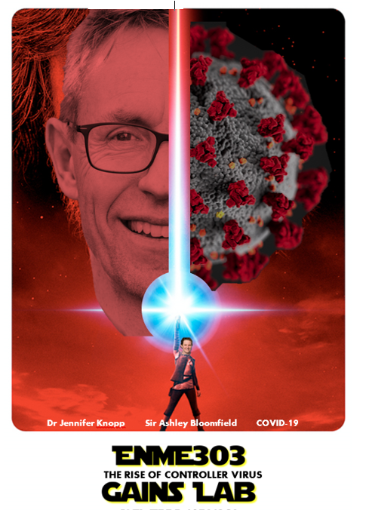
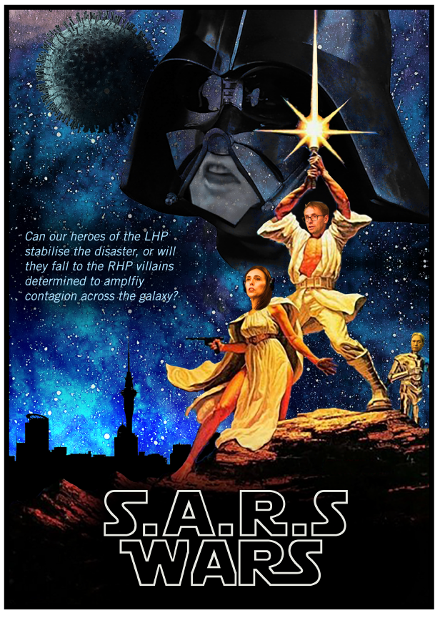

Slide 20
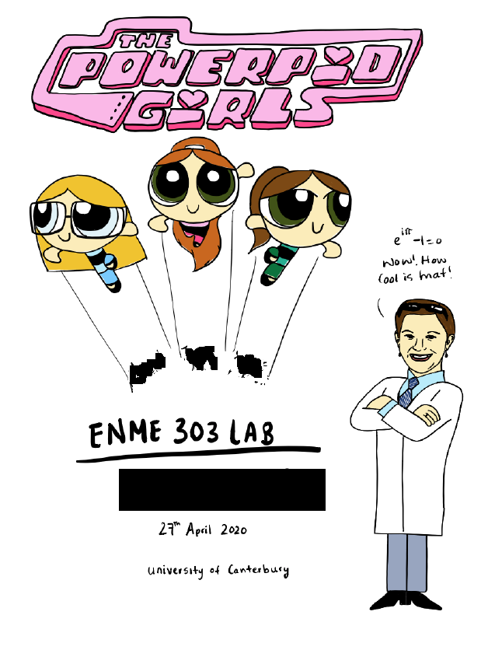
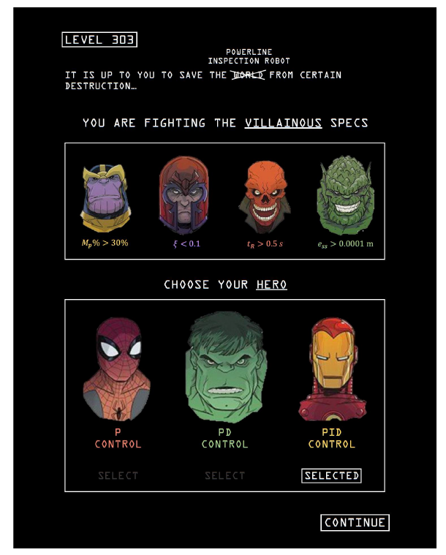

Slide 21
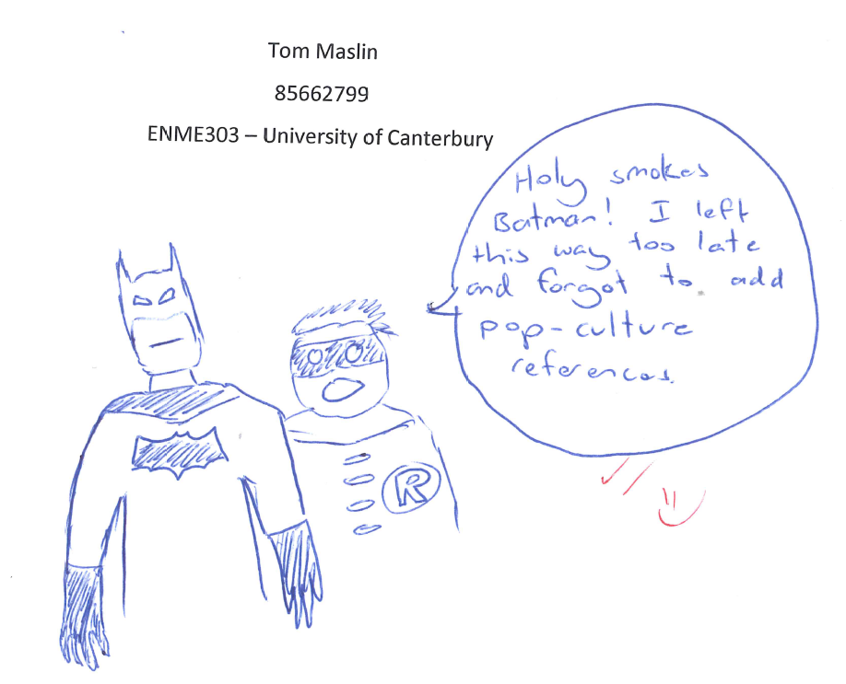
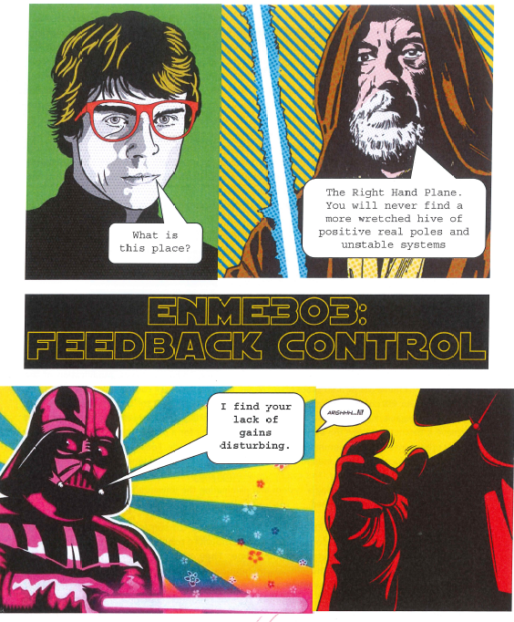
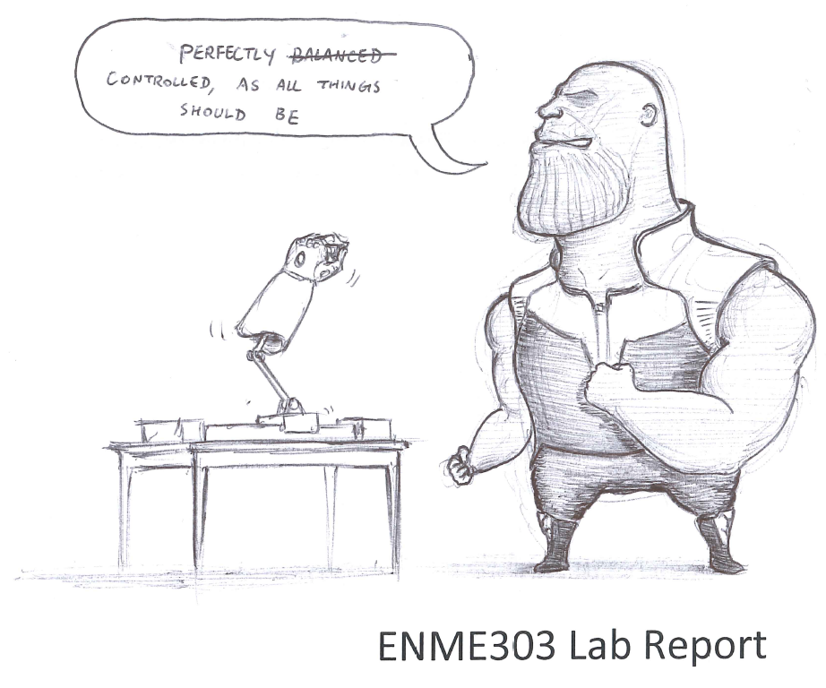

Slide 22


Slide 23
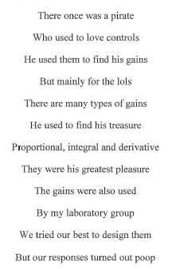

Slide 24
